Slide 1

LAB 18
January 2025

Slide 2
CONTENTS
01
Specification
02
Creating Simple Implication Assertions
03
Simulating Simple Implication Assertions
04
Achieved Outcomes.
Testing the Register Design

Slide 3
Specification
01

Slide 4




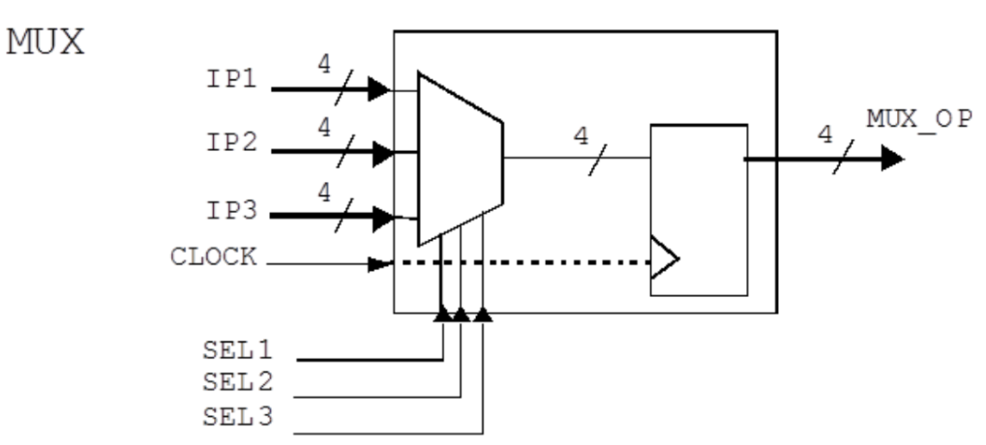
1. Specification
01
ip1, ip2, ip3 and mux_op are 4-bit vectors.
Inputs are sampled on the rising edge of clock.
If sel1 is logic 1, input ip1 is assigned to mux_op.
Otherwise, if sel2 is logic 1, input ip2 is assigned to mux_op.
Otherwise, if sel3 is logic 1, input ip3 is assigned to mux_op.
I/O interface
Notes:
IC: Integrated Circuit

Slide 5
Creating Simple Implication Assertions
02

Slide 6
2. Creating Simple Implication Assertions
01
Working in the lab18-svamux directory, perform the following.
A model for the MUX is provided in the mux.sv file. In this file, assert three properties, evaluated only on the active edge (rising edge) of the signal clock, to do the following:
When sel1 is 1’b1, check that in the next evaluation cycle mux_op equals ip1 from the past cycle" (i.e. use $past()).
When sel2 is 1’b1, check that in the next evaluation cycle mux_op equals ip2 from the past cycle" (i.e. use $past()).
When sel3 is 1’b1, check that in the next evaluation cycle mux_op equals ip3 from the past cycle" (i.e. use $past()).
At this stage, please write the properties to meet the specification above (what the lab book asks for), rather than how you might think the properties should be defined.
Notes:
IC: Integrated Circuit

Slide 7
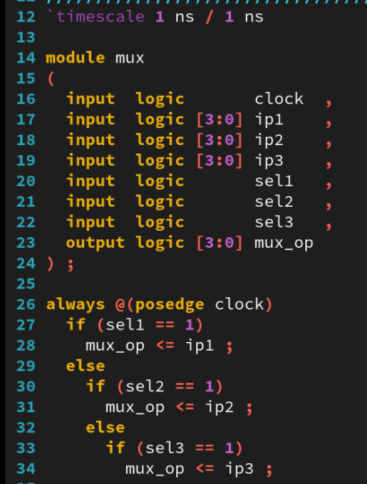
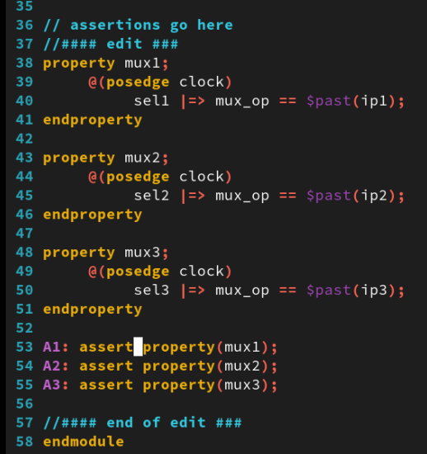
2. Creating Simple Implication Assertions
01
Notes:
IC: Integrated Circuit

Slide 8
Simulating Simple Implication Assertions
03

Slide 9
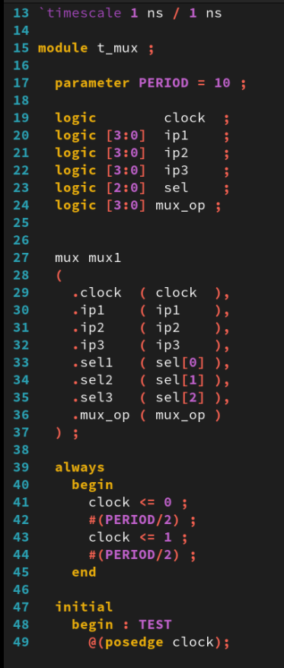
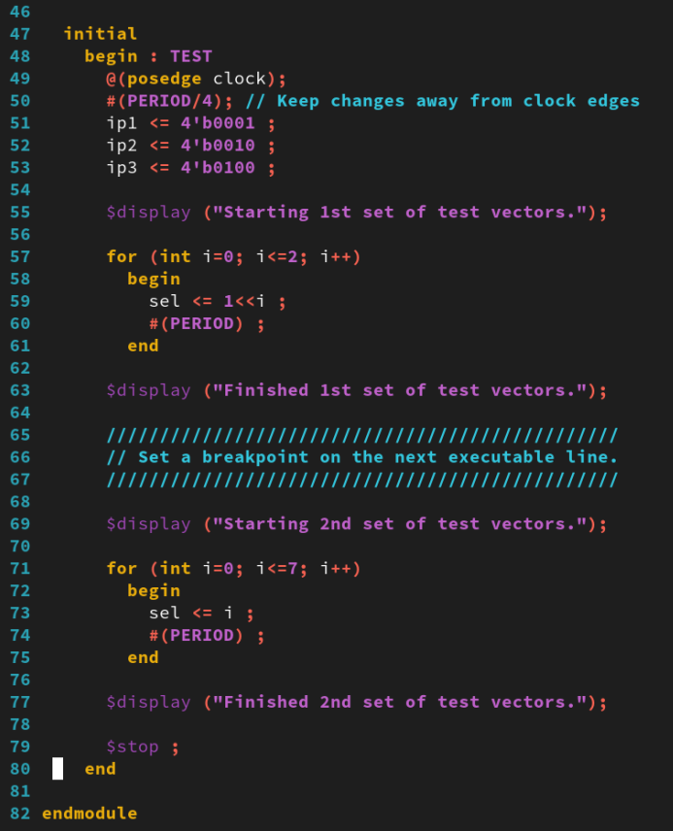
3. Simulating Simple Implication Assertions
01
Examine the MUX testbench file, mux_test.sv. The first part of the testbench floats a logic 1 across each of the MUX select inputs.
The second part of the testbench increments the MUX select inputs through all possible combinations.
Notes:
IC: Integrated Circuit

Slide 10
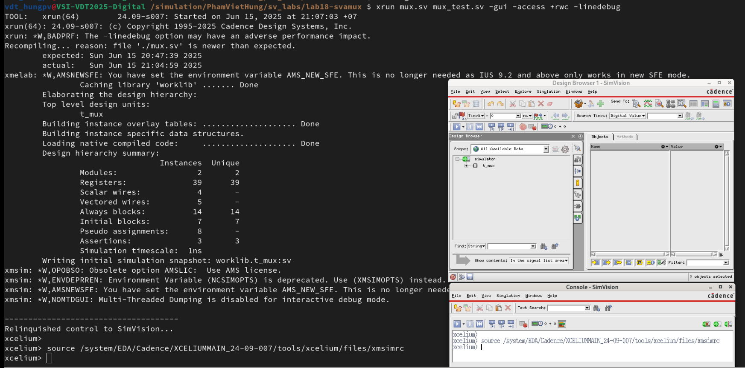
3. Simulating Simple Implication Assertions
01
Simulate your design in GUI mode using the following xrun options:
xrun mux.sv mux_test.sv -gui -access +rwc -linedebug
Then the result as below:
Notes:
IC: Integrated Circuit

Slide 11
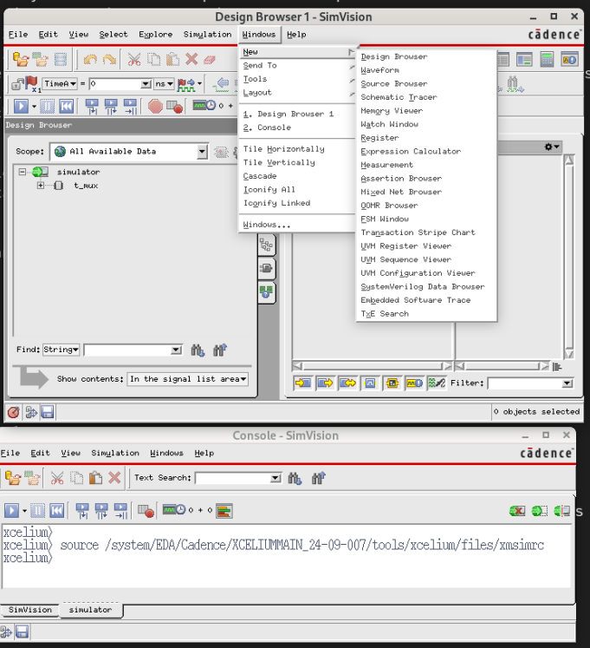
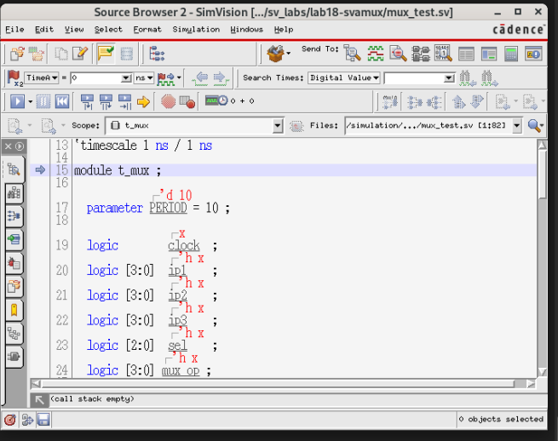
3. Simulating Simple Implication Assertions
01
Before running simulation, set a simulation breakpoint on the first executable line after this comment in the testbench mux_test.sv(line 69):
When Design Browser1 - SimVision open, clicking on the icon or by going to Windows – New – Source Browser.
After following the instructions above: Source Browser 2 - SimVision will open as below:
result after done
Notes:
IC: Integrated Circuit

Slide 12
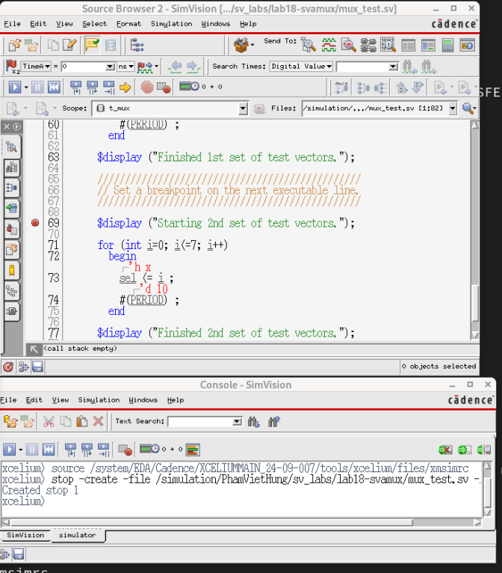
3. Simulating Simple Implication Assertions
01
Set a simulation breakpoint on the first executable line after this comment in the testbench mux_test.sv at Source Browser 2 - SimVision : //Set a breakpoint on next executable line.
Double click at line 69 in the testbench mux_test.sv at Source Browser 2 - SimVision.
The result as below:
Notes:
IC: Integrated Circuit

Slide 13
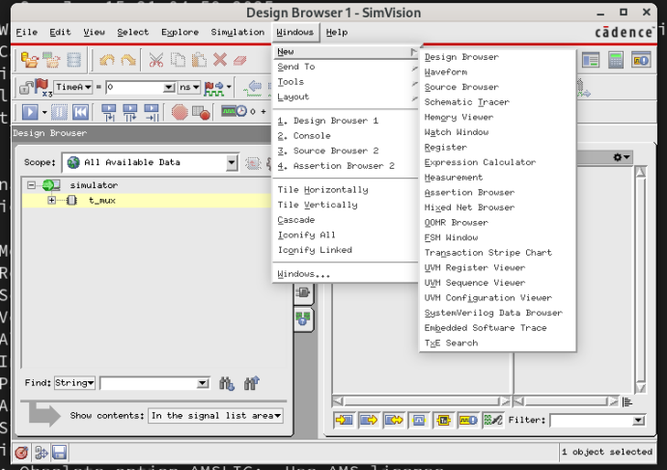
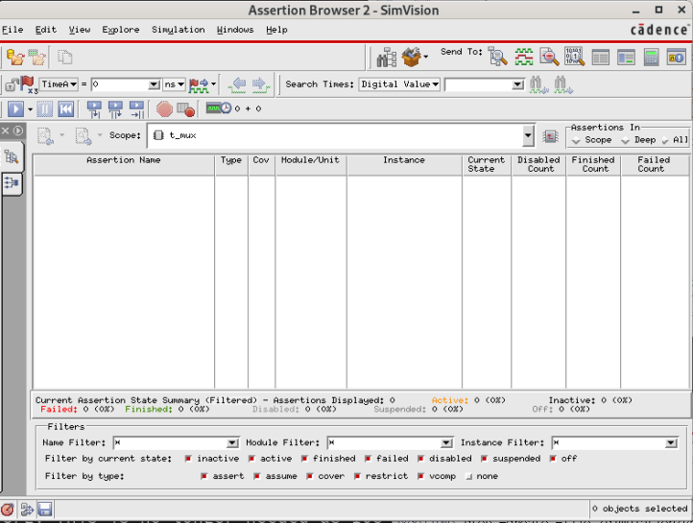
3. Simulating Simple Implication Assertions
01
Find and open the Assertion Browser window and check whether your assertions appear. Use the browser to add your assertions to the waveform window.
At Design Browser1 - SimVision, clicking on the icon or by going to Windows – New – Assertion Browser.
After following the instructions above: Assertion Browser 2 – SimVision will open as below:
Notes:
IC: Integrated Circuit

Slide 14
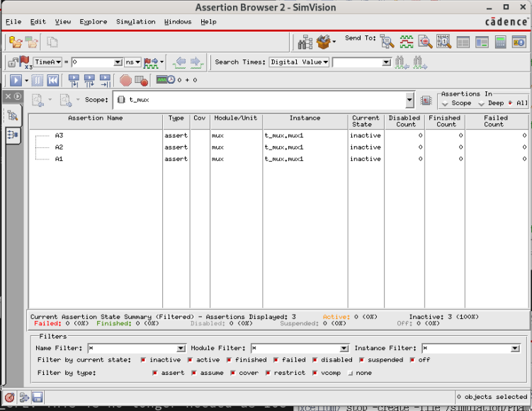
3. Simulating Simple Implication Assertions
01
The Assertion Browser no longer shows all assertions by default.
You need to item All at Assertions In on Assertion Browser 2 – SimVision.
Then Assertion Name will appear as below:
Notes:
IC: Integrated Circuit

Slide 15
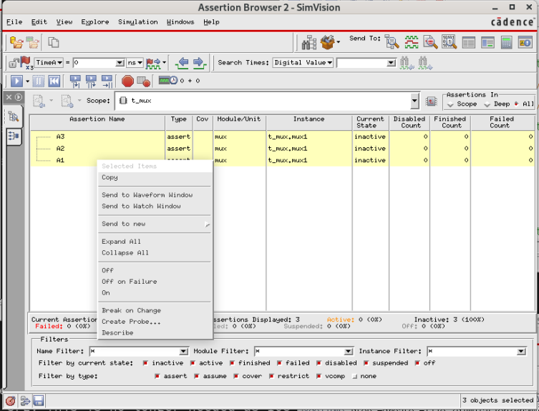
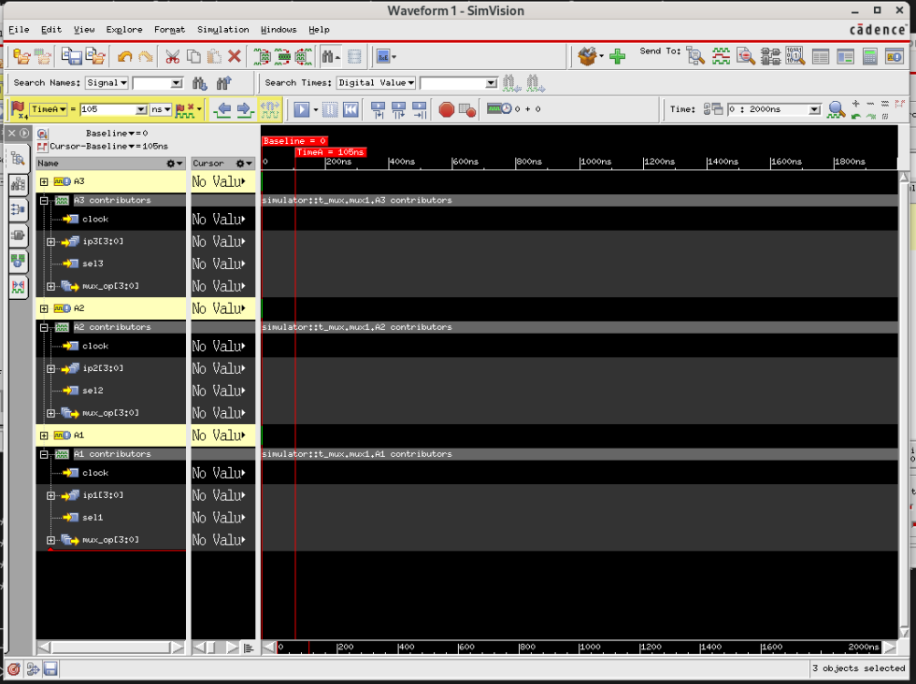
3. Simulating Simple Implication Assertions
01
Add A1 A2 A3 assertions name to the waveform window.
Because not clicked run simulation, so signals has No Value as below:
Notes:
IC: Integrated Circuit

Slide 16
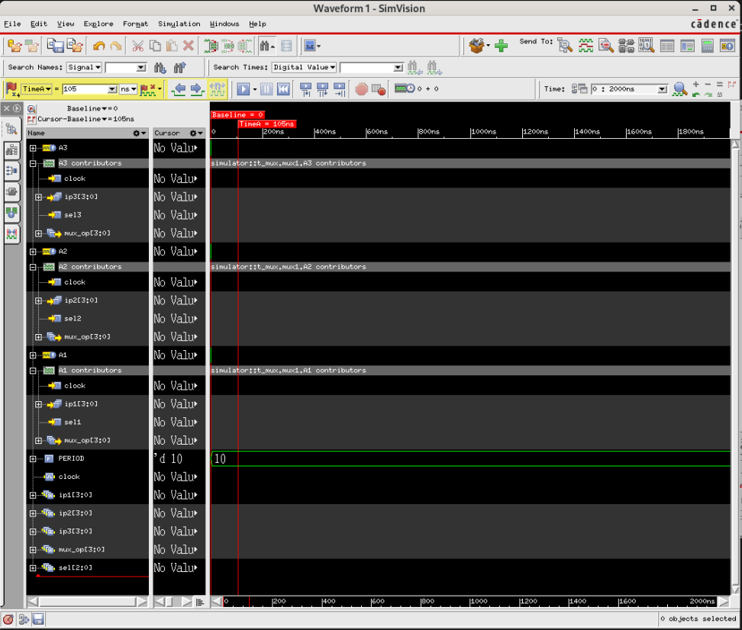
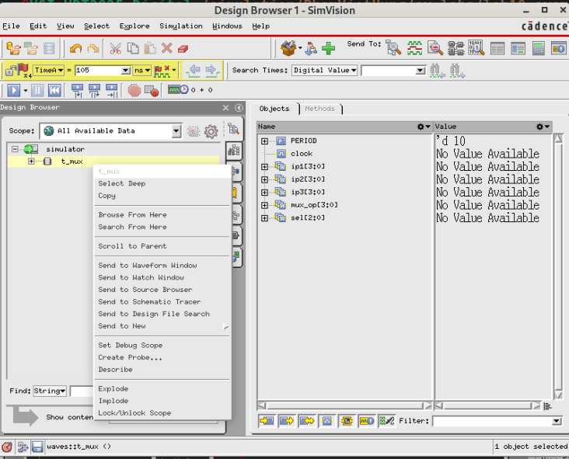
3. Simulating Simple Implication Assertions
01
Use the Design Browser 1 to add the assertion testbench signals to the waveform window.
The result as below:
Notes:
IC: Integrated Circuit

Slide 17
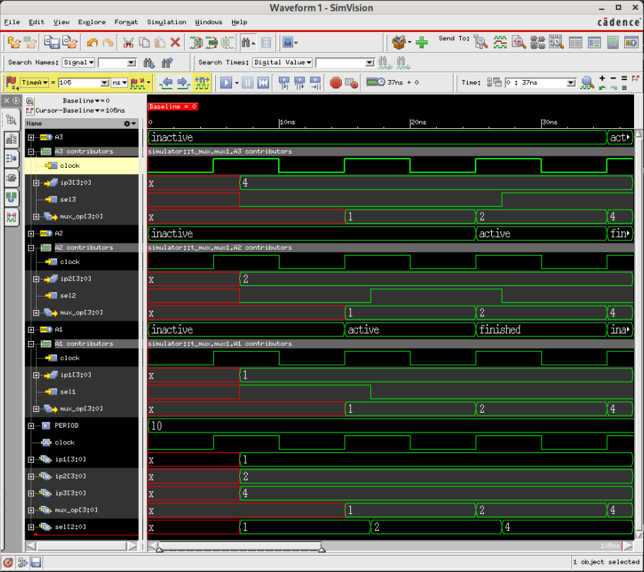
3. Simulating Simple Implication Assertions
01
Simulate with the first set of test vectors by running up to the breakpoint.
Clicking on run the simulation on the side bar at Waveform1 until the program pauses at the breakpoint(line 69).
Notes:
IC: Integrated Circuit

Slide 18
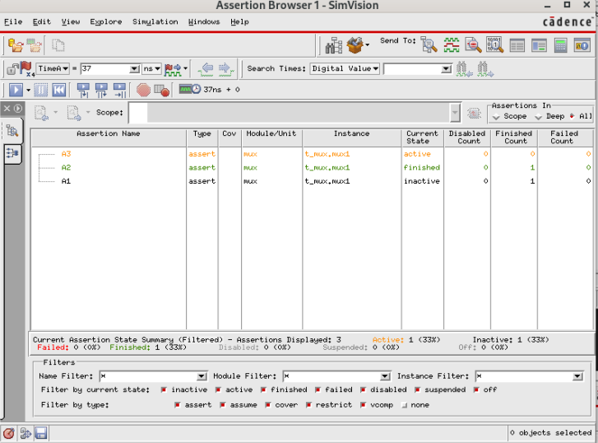
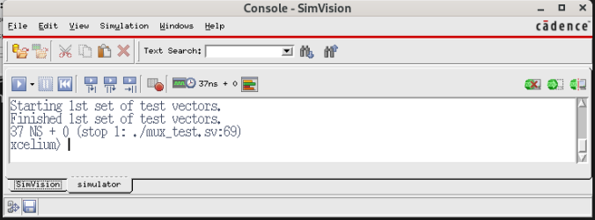
3. Simulating Simple Implication Assertions
01
Simulate with the first set of test vectors by running up to the breakpoint.
The Console display pauses at the breakpoint(line 69) setuped at mux_test.sv.
The Assertion Browser 1 display current state, disabled count, finished count and failed count of Assertion Name
Notes:
IC: Integrated Circuit

Slide 19
3. Simulating Simple Implication Assertions
01
Simulate with the first set of test vectors by running up to the breakpoint.
The Console display pauses at the breakpoint(line 69) setuped at mux_test.sv.
The Assertion Browser 1 display current state, disabled count, finished count and failed count of Assertion Name
Notes:
IC: Integrated Circuit

Slide 20
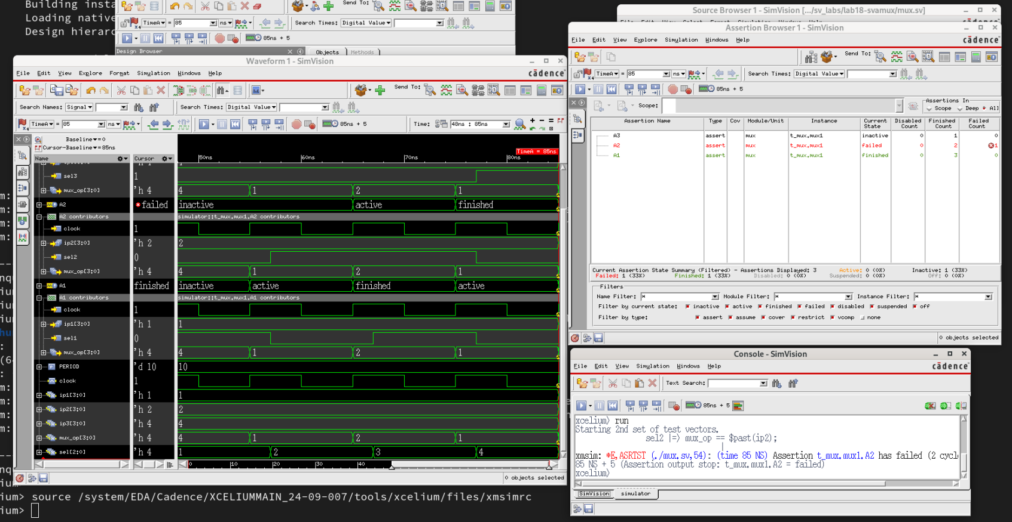
3. Simulating Simple Implication Assertions
01
Run the simulator from the breakpoint until the end of simulation. Note that the simulator may stop every time a property fails or a breakpoint is hit. Keep running until the end of simulation as indicated by a message in the command window.
The reult of next run(2nd time) simulationas as below(apper failed of Assertion Name A2):
Notes:
IC: Integrated Circuit

Slide 21
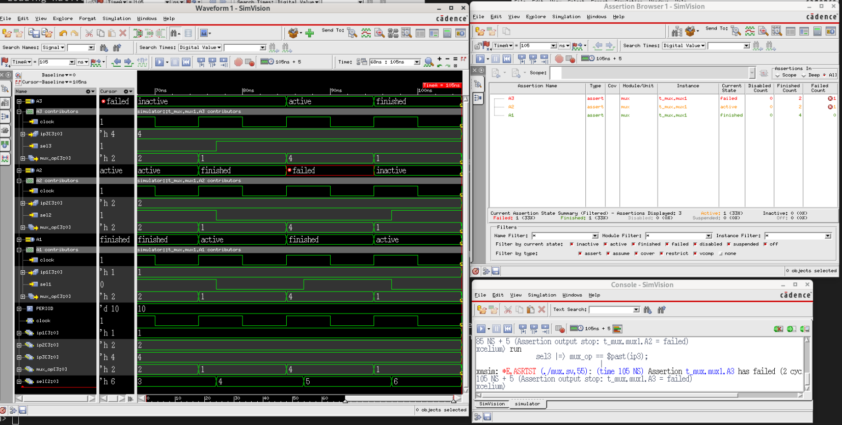
3. Simulating Simple Implication Assertions
01
Continue run simulation(3rd time) and the result as below(appear new failed of Assertion Name A3)
The simulation is finished.
Notes:
IC: Integrated Circuit

Slide 22
3. Simulating Simple Implication Assertions
01
Continue run simulation(3rd time) and the result as below(appear new failed of Assertion Name A3).
Notes:
IC: Integrated Circuit

Slide 23
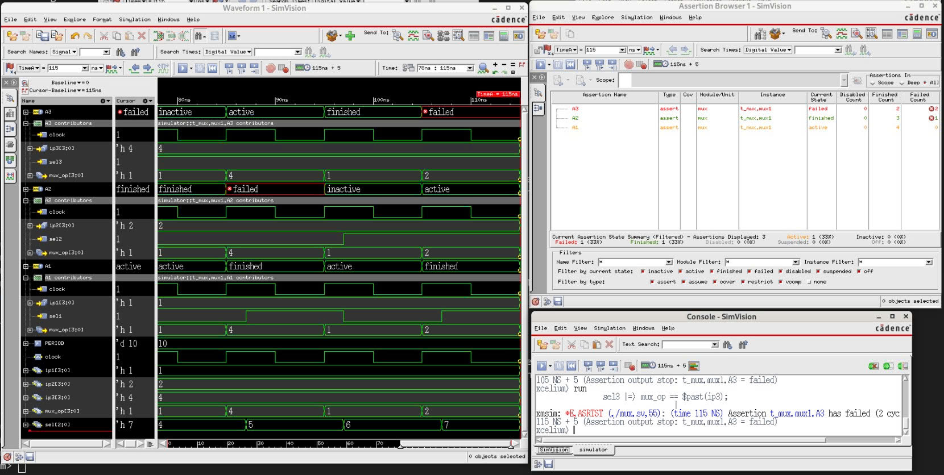
3. Simulating Simple Implication Assertions
01
Continue run simulation(4nd time) and the result as below(appear new failed of Assertion Name A3).
Total has 2 failed of A3
Notes:
IC: Integrated Circuit

Slide 24
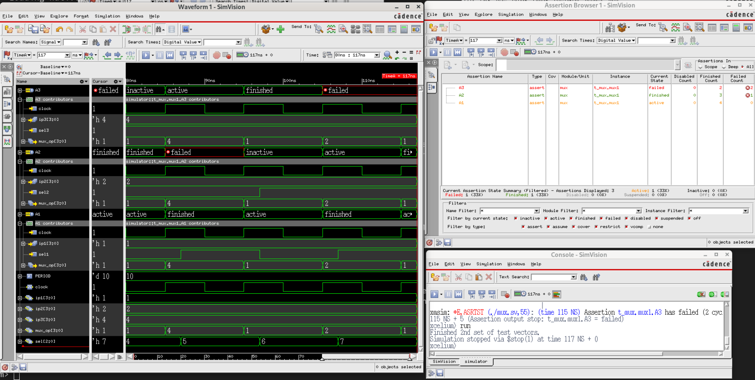
3. Simulating Simple Implication Assertions
01
The simulation finished.
Notes:
IC: Integrated Circuit

Slide 25
3. Simulating Simple Implication Assertions
01
Second and third property assertions have failed. Because assertions mux2 và mux3 have loose conditions.
And when run simulation if sel1 and sel2 are high, then mux2 not selected → simulation failed.
Similar mux3 not selected if sel1 or sel2 is high → simulation failed.
Notes:
IC: Integrated Circuit

Slide 26
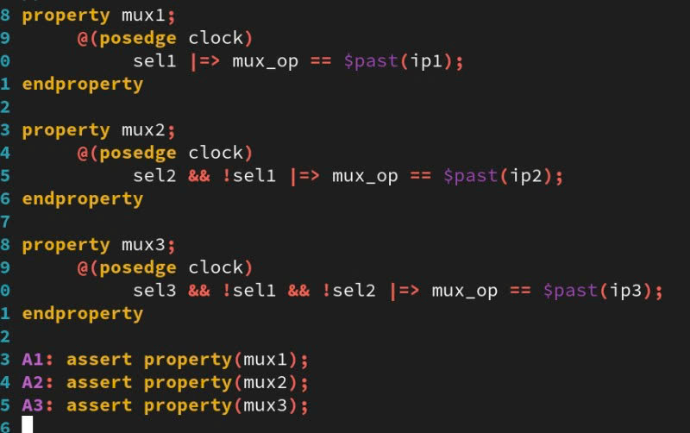
3. Simulating Simple Implication Assertions
01
Modifying the Assertions
The property specification provided above is incomplete.
The properties did not consider the priority of the selx select inputs, as specified in the Functionality section above (look at the properties in the waveform viewer to see what the inputs are when the assertions failed).
Edit your assertions to account for the selx priority.
Rerun the simulation (remember to continue past the breakpoint). Steps as above instruction
Notes:
IC: Integrated Circuit

Slide 27
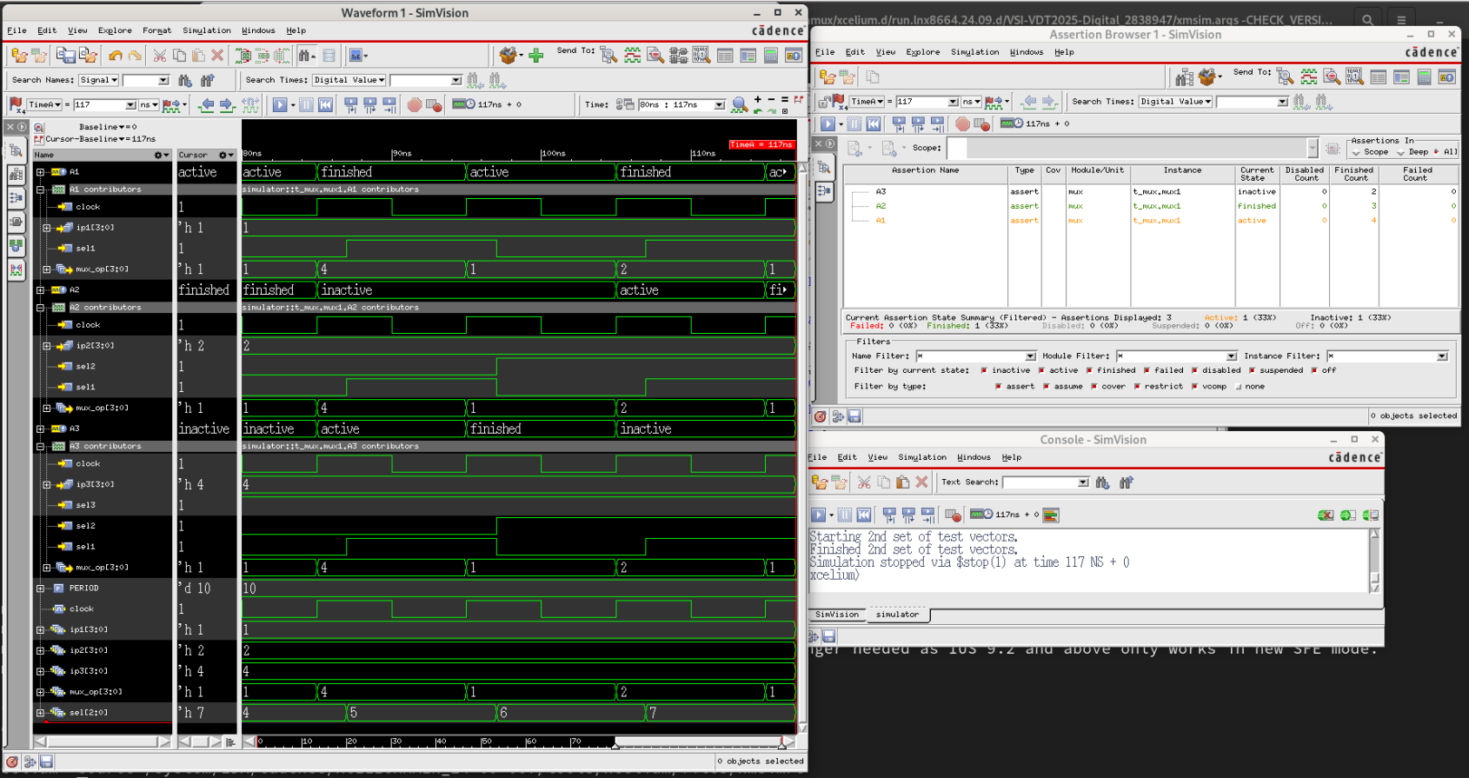
3. Simulating Simple Implication Assertions
01
Modifying the Assertions
Confirm that your new properties hold throughout the simulation.
The result as below(error free):
Notes:
IC: Integrated Circuit

Slide 28
Achieved Outcomes.
04

Slide 29
4. Achieved Outcomes
01
Understand the specification and create and simulate simple implication SystemVerilog assertions.
One of the aims of this exercise is to teach you an important lesson on assertions. Assertions are ineffective if:
The test data is incomplete, as in the first set of stimuli.
The assertions are incorrectly written, as with our initial properties.
Notes:
IC: Integrated Circuit

Slide 30

THANK YOU!

